Slide 1
Measurement and Characterization of a 5T Solenoid Field
Jason Morgan
April 2018

Slide 2
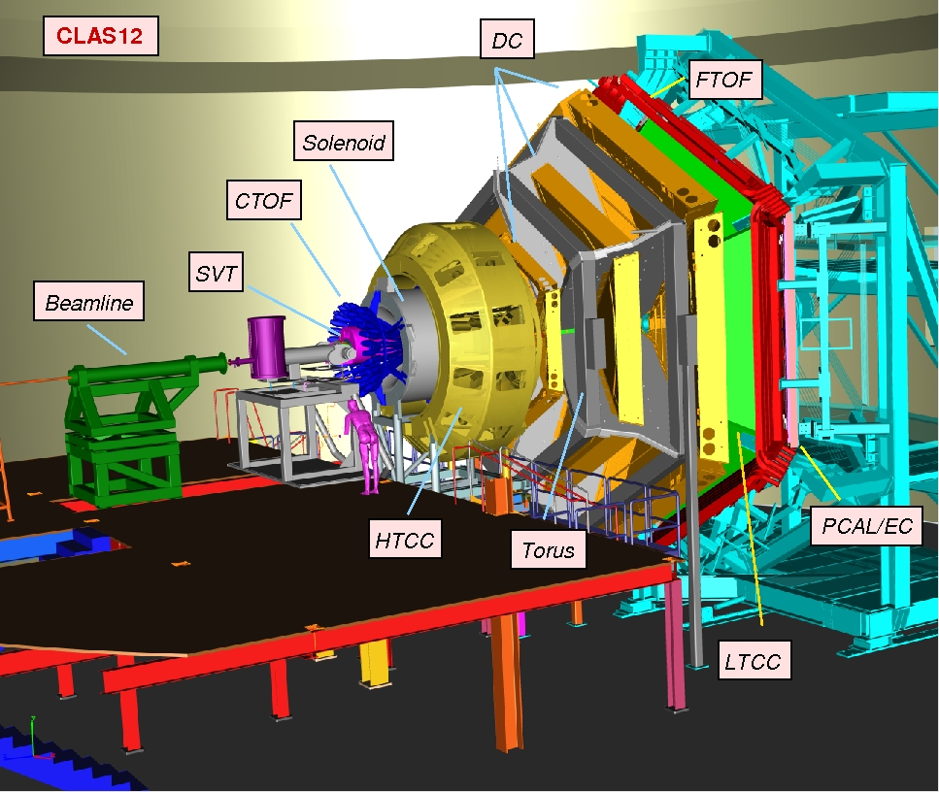
CLAS12
CEBAF Large Acceptance Spectrometer for 12 GeV
3.58T toroidal magnet
5T Solenoid

Slide 3
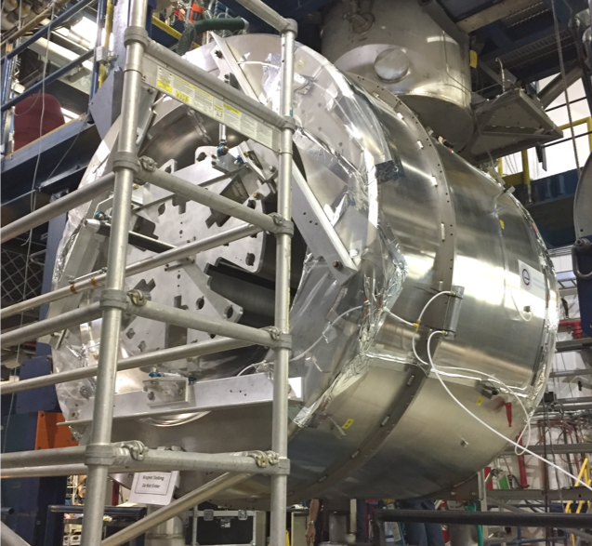
5T SOLENOID
Shields the detectors from the background
Gides high angle particles to the detector
5 coils, 4 main + 1 shield coil
5T central field at 2416A
Installed September 2017
Magnetic field mapped September – October 2017

Slide 4
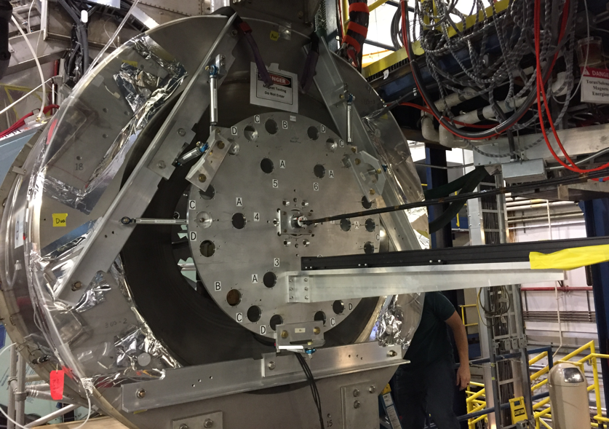
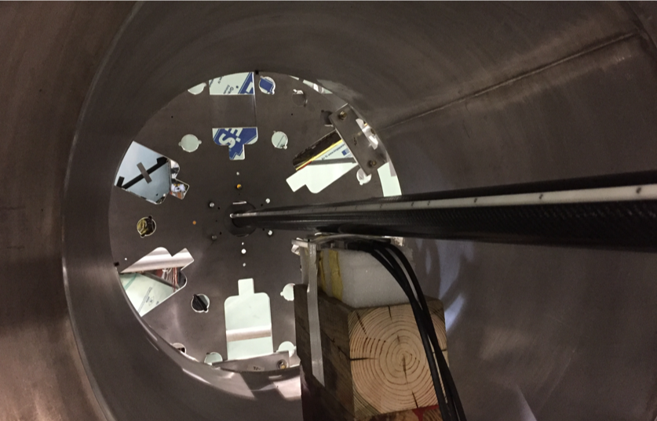
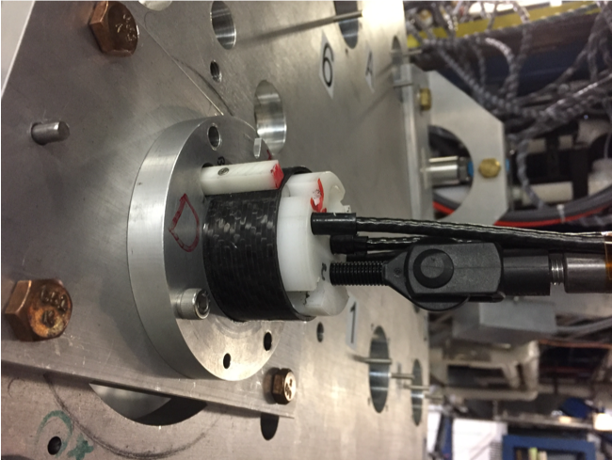
FIELD MAPPING

Slide 5
FIELD MAPPING
Template board with hole to mount probe tube
38 runs of data were looked at at r=0, r=1.25cm and r=30cm
Runs were conducted with various angles of rotation for r = 1.25cm and r=30cm runs
Probes were rotated in the holder at angles of 90, 180 and 270 degrees

Slide 6
FIELD MAPPING
Long runs were performed in steps of 2cm spanning a total distance of 200cm
Short fine integral runs were performed in 1mm steps spanning a total distance of 10 cm
Hall probes were inserted in the tubes and pushed down the z axis in 2cm steps for long runs and 1mm steps for short runs

Slide 7
FINDING THE CENTER
Found the center by reflecting the data about various z values that covered the ranges where the apparent center of the field was located
Performed a χ² test and selected the minimum χ²
Calculated χ² for surrounding z values and fit with a quadratic model
Projected this model in 0.01cm steps and selected the minimum to establish the center point for each run
Center z for long runs is 89.8 ± 2.3 cm
Center z for short runs is 53.4 mm ± 5.0 mm.

Slide 8
SCALING
The run data for the B_{z} and B_{y} fields was scaled to the model for comparison
All B_{x} and B_{y} at r = 0 were not scaled since they are theoretically 0

Slide 9
TRANSLATIONS
Probe Rotation (pr)° | NormalizedB_{x =} | NormalizedB_{y =}
0 | B_{x} | B_{y}
90 | B_{y} | -B_{x}
180 | -B_{x} | -B_{y}
270 | -B_{y} | B_{x}

Slide 10
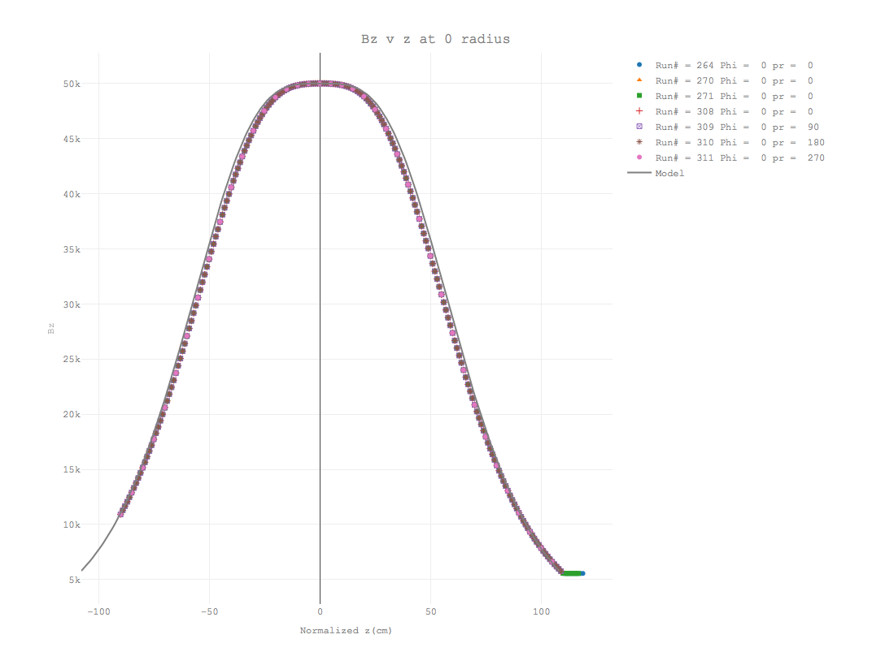
RESULTS

Slide 11
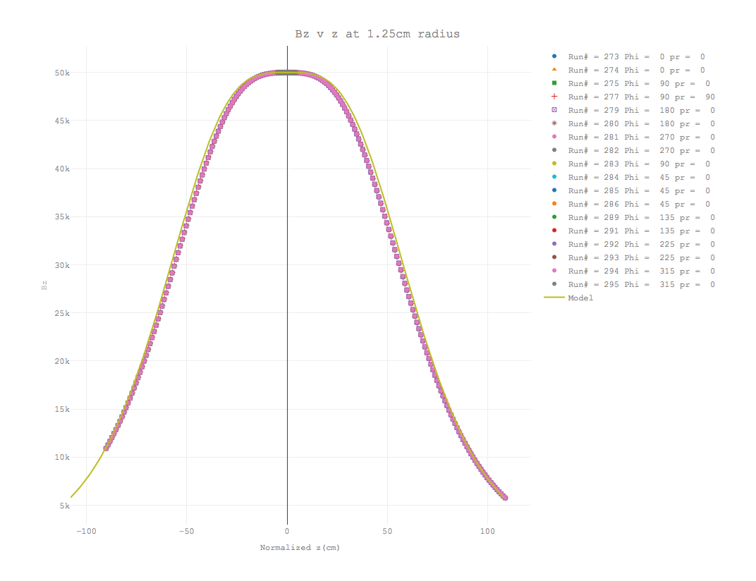
RESULTS

Slide 12
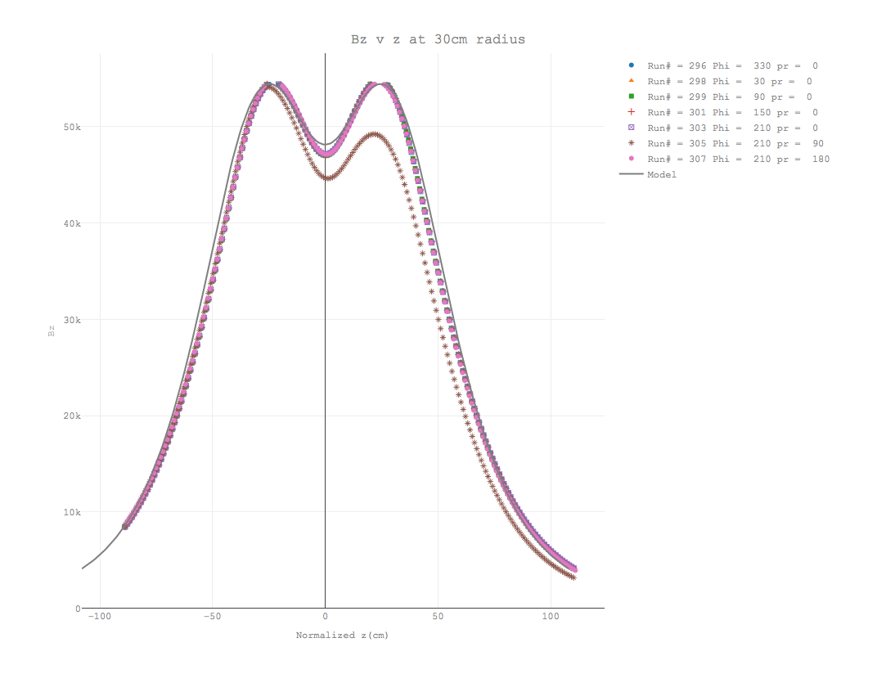
RESULTS

Slide 13
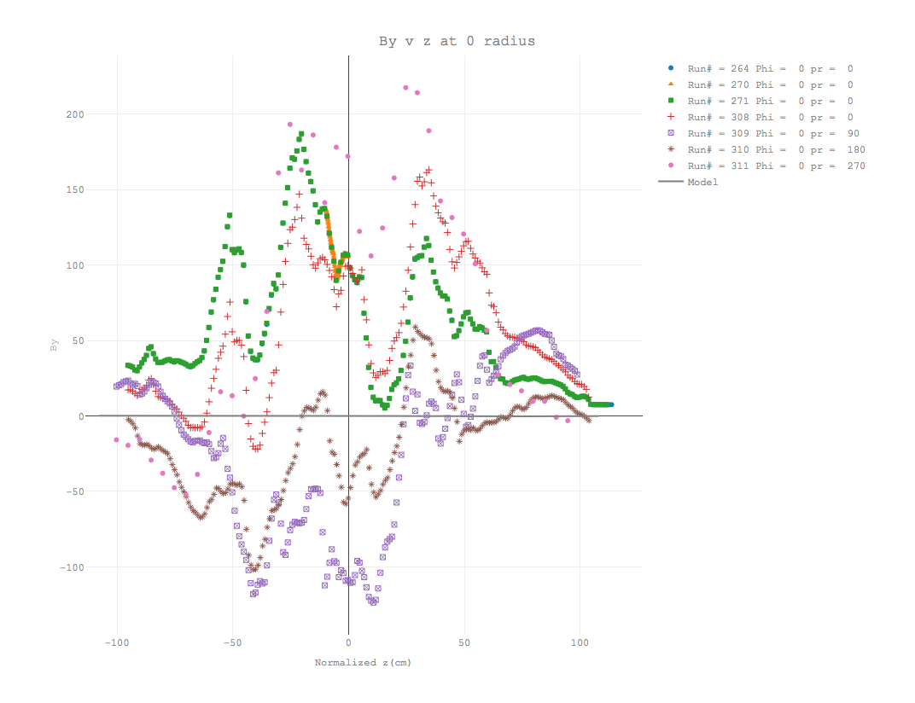
RESULTS

Slide 14
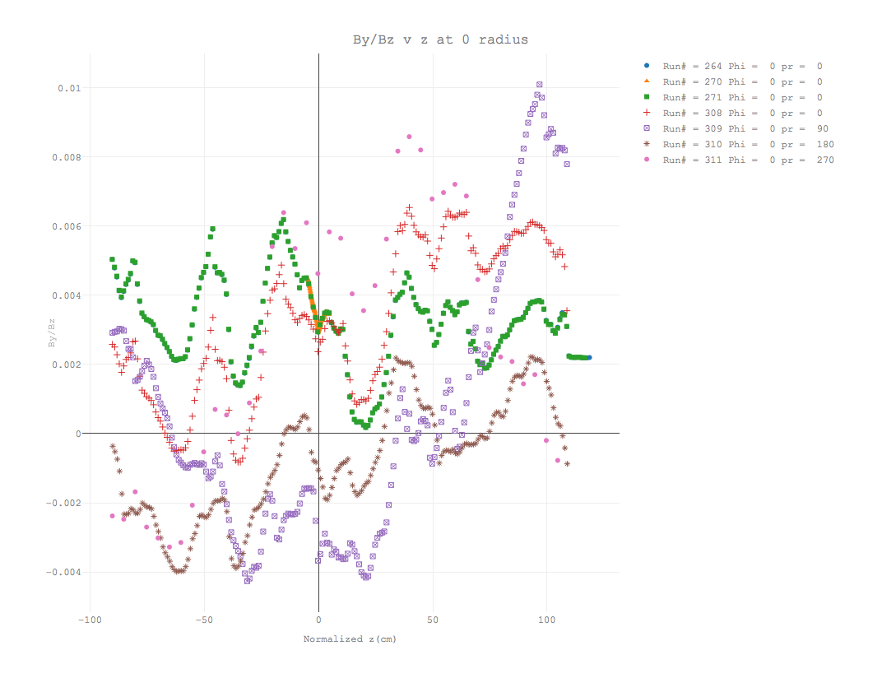
RESULTS

Slide 15
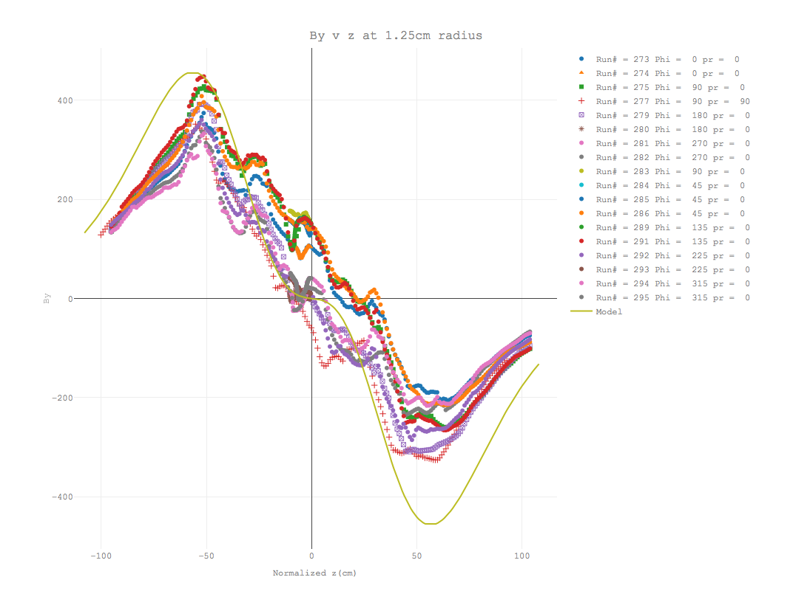
RESULTS

Slide 16
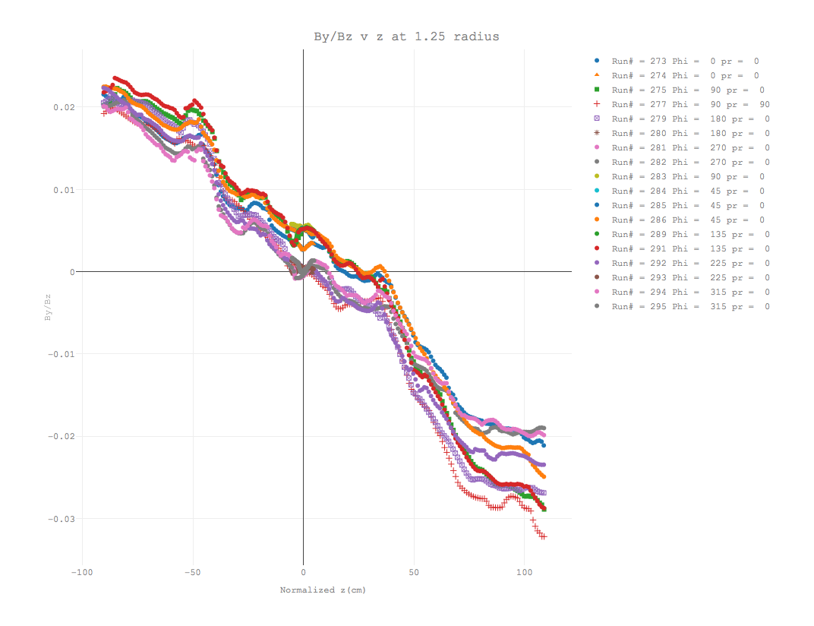
RESULTS

Slide 17
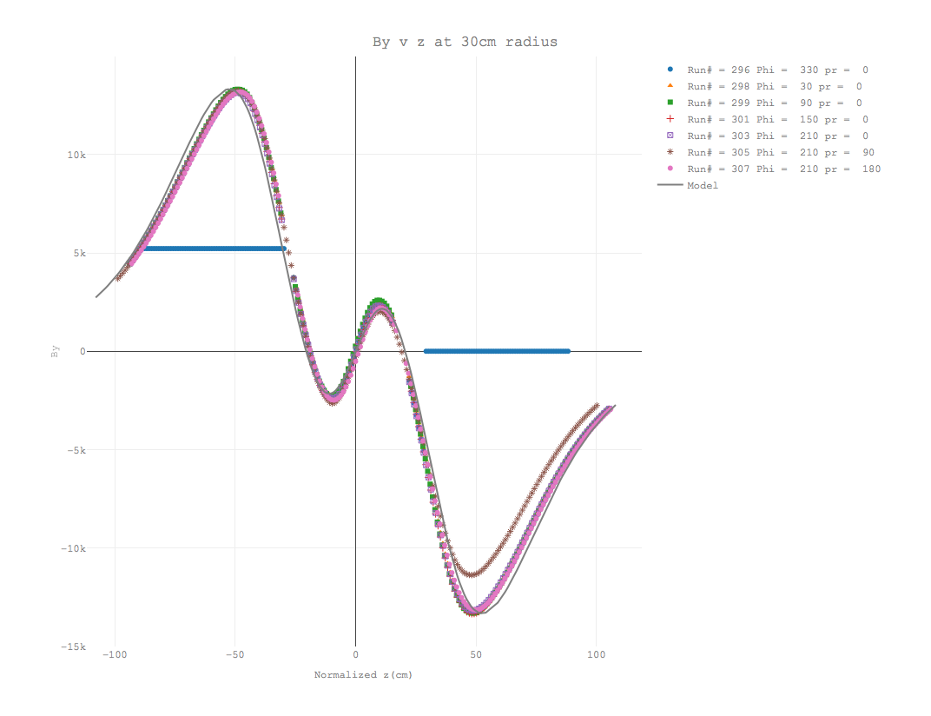
RESULTS

Slide 18
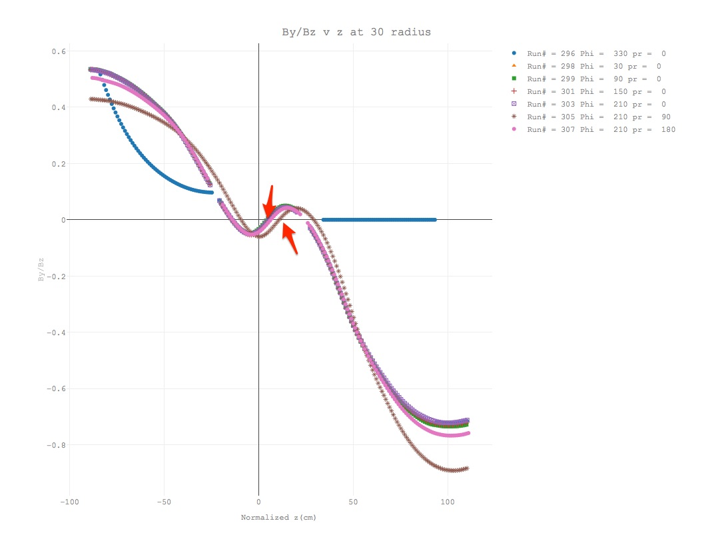
RESULTS

Slide 19
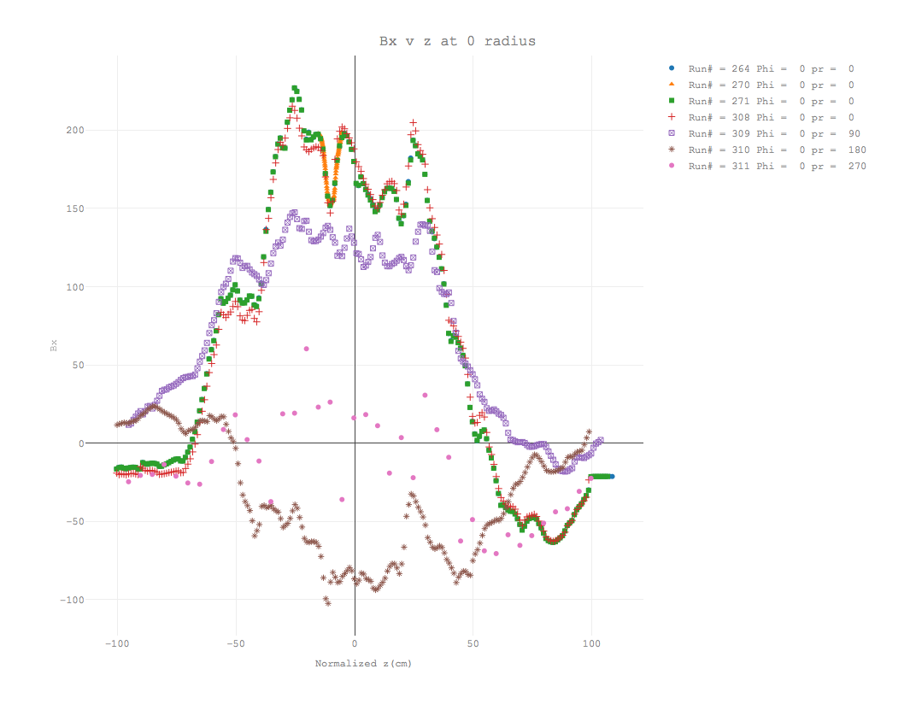
RESULTS

Slide 20
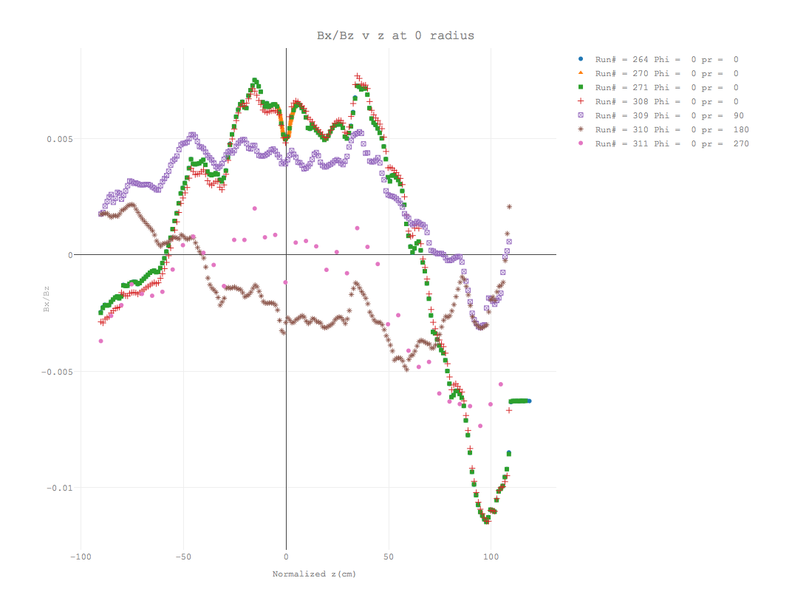
RESULTS

Slide 21
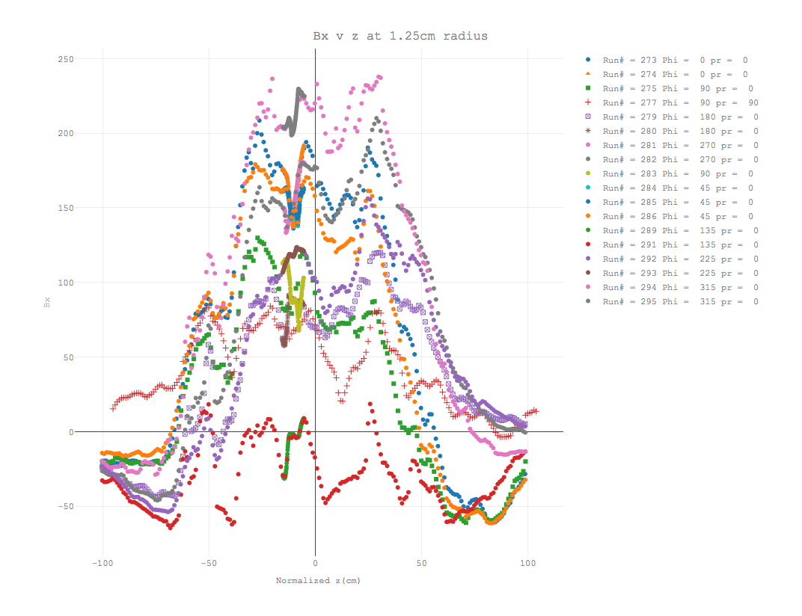
RESULTS

Slide 22
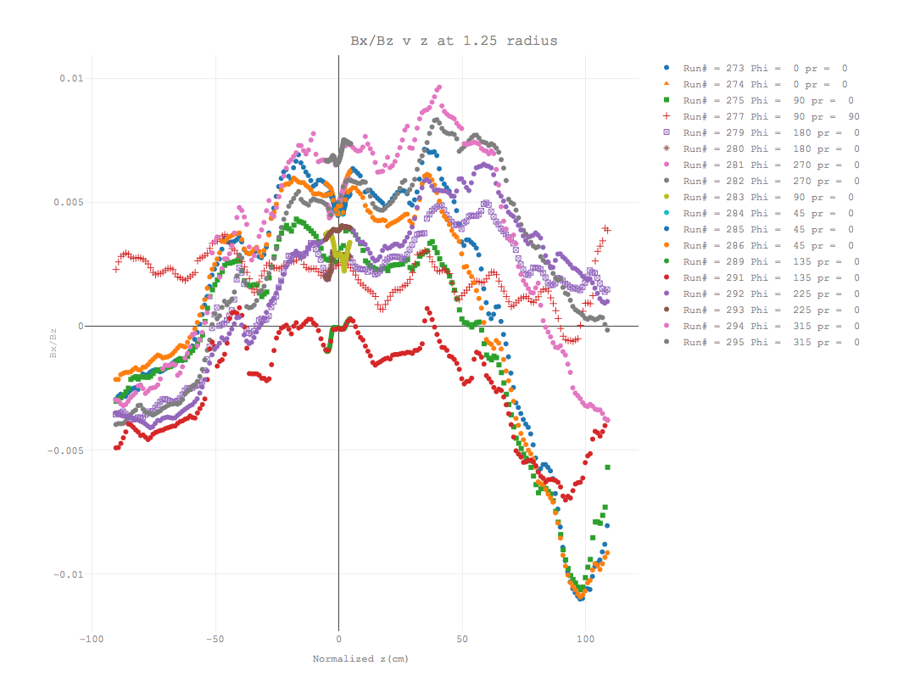
RESULTS

Slide 23
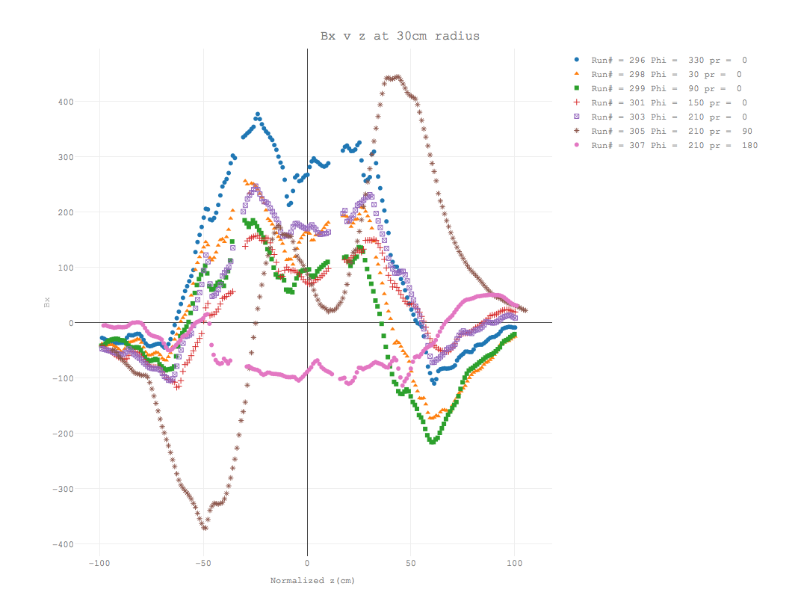
RESULTS

Slide 24
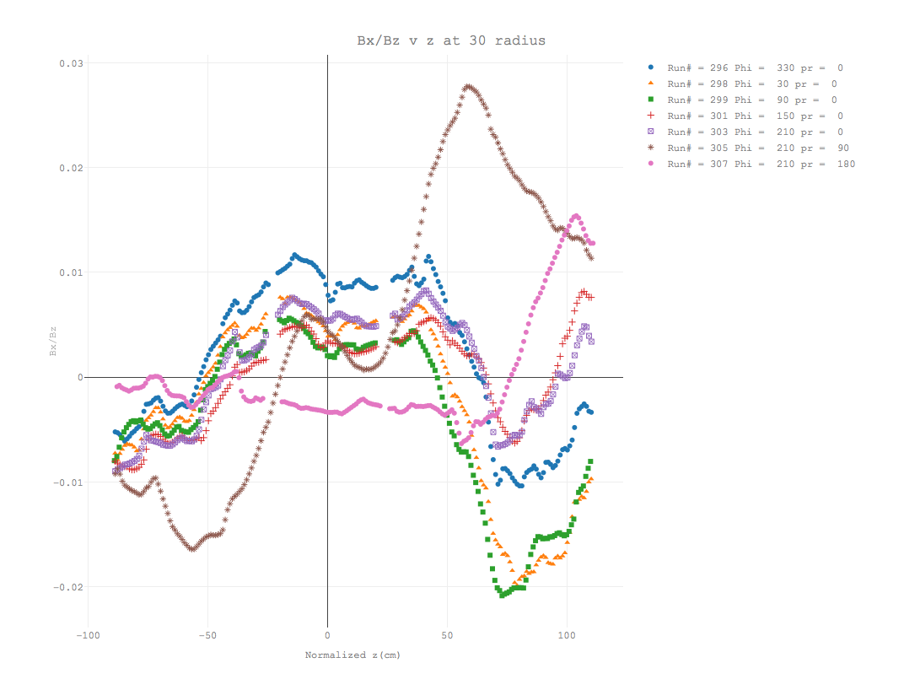
RESULTS

Slide 25
Conclusions and Outlook
Center z values vary by ±2.3cm between long runs
Center z values vary by ±0.50cm between short runs
There appears to be motion on the probe holders other than along the z axis
Isolate contribution of probe motion
Parameterization of the deviations from the model
….

